Slide 1


WHEAT PRICE PREDICTION
Business, Economic and Financial Data
Supervisor: Prof. Mariangela Guidolin
Karakus Isikay
Mahfouz Auriane

Slide 2
OUTLINE
1
EXPLORATORY DATA ANALYSIS
INTRODUCTION
2
3
DATA MODELLING
4
MODELS COMPARISON &
FORECASTING

Slide 3



INTRODUCTION
1
A vital food source for all living beings aka “edible gold”
Notes:
We are focusing on wheat as it is a vital source of food, not only for humans but also for animals. We can say wheat is our 'edible gold,' wheat is essential in our diets. By predicting the price of this crucial food source, we aim to understand and prepare for potential food catastrophes, ensuring our survival and food security.

Slide 4

PROJECT SPECIFICATIONS
Our aim is to develop a reliable model for predicting and forecasting wheat prices for the next 5 years.
Notes:
What we will do what is our goal? In terms of forecasting

Slide 5
FACTORS THAT INFLUENCE THE WHEAT PRICE
Political and
Economic
Stability
Government
Policies and
Subsidies
Weather
Conditions
Currency
Fluctuations
Technological
Advances
Global Supply
and Demand
Global Events
Energy Costs
Market
Speculation
Changes in
Consumption
Patterns
Notes:
In our analysis, we consider a range of factors influencing wheat prices, from climatic conditions to international trade policies, providing a holistic view of the market dynamics. These are general factors that are influencing the wheat price overall.

Slide 6





DATA COLLECTION & DATASET INTRODUCTION
Wheat price (1990-2022) [Main Dataset]
Pasta price (1984-2023)
Flour price (1980-2023)
Export Quantity (1990-2022)
Export Value (1990-2022)
Import Quantity (1990-2022)
Import Value (1990-2022)
Global Land and Ocean January-December Temperature Anomalies
(1990-2023)
Crop Production (1990-2023)
Supply and Disappearances (2003-2023)
Notes:
Price Data: We have datasets that show the yearly prices of wheat, pasta, and flour in US dollars per metric ton.
Trade Data: We analyze the export quantity, export value, import quantity, and import value across different countries, focusing solely on wheat by filtering out other wheat products like buckwheat.
Climate Data: We examine the Global Land and Ocean Temperature Anomalies from January to December. This data illustrates climate change by comparing current temperatures with historical averages.
Production Data: Our crop production dataset includes various types of grains. We have refined this to feature wheat production data by country and by year.
Usage Data: The Supply and Disappearances dataset measures domestic disappearance in million metric tons, which accounts for all uses of wheat, from animal feed to flour production.

Slide 7

2
EXPLORATORY DATA ANALYSIS

Slide 8
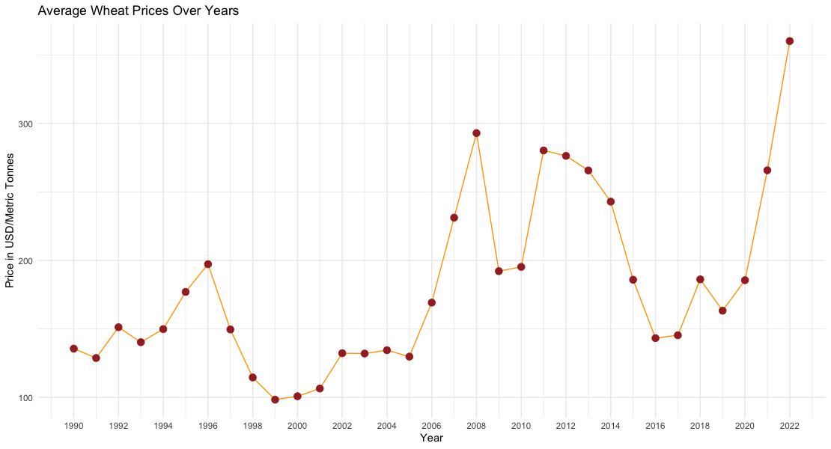
WHEAT PRICE
Notes:
When we converted the data into a time series, we used their annual averages because of certain components in our dataset. After calculating the weighted averages for prices, we obtained this plot. It clearly shows four main peaks over the years.

Slide 9
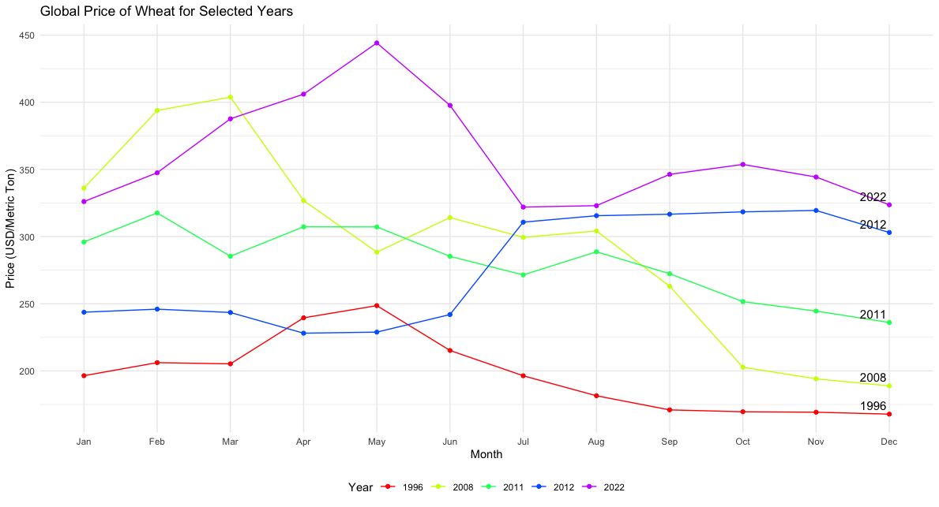

WHAT HAPPENED EXACTLY?
MAY 2022
MARCH 2008
JULY 2012
FEBRURAY 2011
MAY 1996

Slide 10


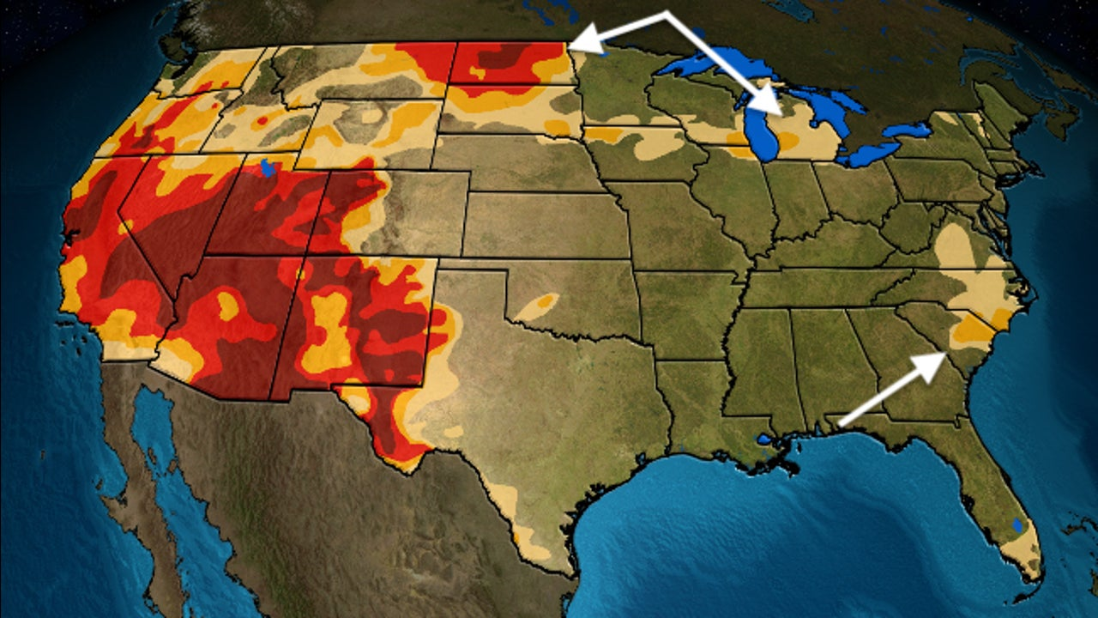
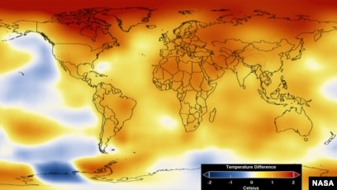
WHAT HAPPENED IN THESE YEARS & HOW DID IT AFFECT THE WHEAT PRICE?
NASA: 2012 Was 9th Hottest Year on Record for the 36th years in a row
Drought in
the Midwest and West
1996
2011-2012
2008
2022
Global Food Crisis
Russian invasion of Ukraine
Floods In Argentina And Australia In 2011
Export ban of Russia
Notes:
May 1996: Wheat prices increased significantly due to a combination of factors. Pessimistic forecasts were a primary reason for the unusual increase in prices at the end of the 1995-96 crop year, leading to an average price per bushel of wheat of $4.55, a 31.6-percent increase over the previous year. The producer price index for corn, soybeans, and wheat all rose considerably, meeting the criteria for a grain price shock. A Midwest drought and below-average worldwide production also contributed to pushing wheat prices to their highest level since 1973​​​​​​. In 1996 wheat priced increased by 15.2 percent due to
Drought in the Midwest and West region in the US, pessimistic crop forecasts, and robust foreign demand affected the magnitude of the shock.
March 2008: The global food crisis in 2008 saw a dramatic increase in wheat prices. By March 2008, average world wheat prices were 130% above their level a year earlier. This was part of a broader surge in food prices, with rice and maize also experiencing significant increases. The spike in wheat prices was characterized by a sharp rise, reaching a peak in the main export countries during February-March 2008, followed by a sudden decline. The world price of wheat saw a substantial boom, reaching as much as $400 per ton in March 2008​​​​​​. Global Food Crisis 2008
As of March 2008, average world wheat prices were 130% above their level a year earlier, he wheat price reached its maximum in the main export countries during February-March 2008. Droughts in major wheat-producing countries in 2005-06
Low grain reserves (according to Holt-Giménez and Peabody, we have less than 54 days worth, globally)
High oil prices
February 20111 Argentina and floods in Australia and unpredictable weather caused a poor wheat crop in Russia Impact on Domestic Market Integration: During the export ban, there was strengthened integration of the domestic wheat market in Russia. This was due to the redirection
of wheat exports to drought-affected regions within Russia, which helped in stabilizing prices and increasing wheat availability in deficit areas. However, post-ban, the market integration reverted to pre-ban levels​​​​.
July 2012: Global food prices soared by 10 percent in July 2012, driven by severe droughts and high temperatures in the United States and Eastern Europe. Maize and wheat prices rose by 25 percent each from June to July. Despite the forecast of the second highest world wheat production on record for 2012, wheat prices increased due to these adverse weather conditions, reaching a record season average farm price of $7.80 per bushel for 2012/2013​​​​​​. NASA: 2012 Was 9th Hottest Year on Record for the 36th years in a row
2012 was among the 10 warmest years on record, rising above the long-term average for the 36th year in a row, according to data released on Tuesday.
2012 the ninth hottest year on record globally.
May 2022: In May 2022, the U.S. season-average farm price for wheat was projected to reach a record $10.75 per bushel, supported by tight domestic stocks. The average of three important wheat prices increased by 165 percent between May 2021 and May 2022, largely influenced by the Russia-Ukraine war and related geopolitical tensions. Old-crop May 2022 wheat futures price increased significantly, and the crisis in Ukraine played a crucial role in this price surge​​​​​​​​.
May 1996: Wheat prices saw a significant rise due to a blend of factors. Pessimistic crop forecasts, along with a severe drought in the Midwest and West regions of the U.S., led to lower production expectations. This, coupled with strong foreign demand, pushed wheat prices to their highest levels since 1973. The average price per bushel of wheat climbed to $4.55, marking a 31.6% increase from the previous year. This rise was part of a broader grain price shock, with the producer price index for key grains like corn, soybeans, and wheat all experiencing substantial increases.
March 2008: The global food crisis of 2008 was marked by a sharp escalation in wheat prices. By March 2008, the average global wheat price was 130% higher than the previous year. This spike was a result of several factors: droughts in major wheat-producing regions during 2005-06, low global grain reserves, and soaring oil prices. The wheat price peaked in major export countries between February and March 2008, with the world price reaching up to $400 per ton, followed by a rapid decline.
July 2012: In July 2012, global food prices surged by 10%, driven largely by extreme droughts and high temperatures in the United States and Eastern Europe. This led to a 25% increase in both maize and wheat prices from June to July. Notably, this occurred despite predictions of the second highest global wheat production on record for that year. The season average farm price for wheat reached a record $7.80 per bushel for 2012/2013. The year 2012 was also significant for being the ninth hottest year on record globally, continuing a trend of rising temperatures.
May 2022: The wheat market in May 2022 was heavily impacted by the Russia-Ukraine war and ensuing geopolitical tensions. This led to a projected record high U.S. season-average farm price for wheat of $10.75 per bushel, driven by tight domestic stocks. The average prices of key wheat varieties increased by 165% from May 2021 to May 2022. The escalation in old-crop May 2022 wheat futures price was a direct reflection of the crisis in Ukraine, highlighting the profound impact of geopolitical events on global agricultural markets.

Slide 11
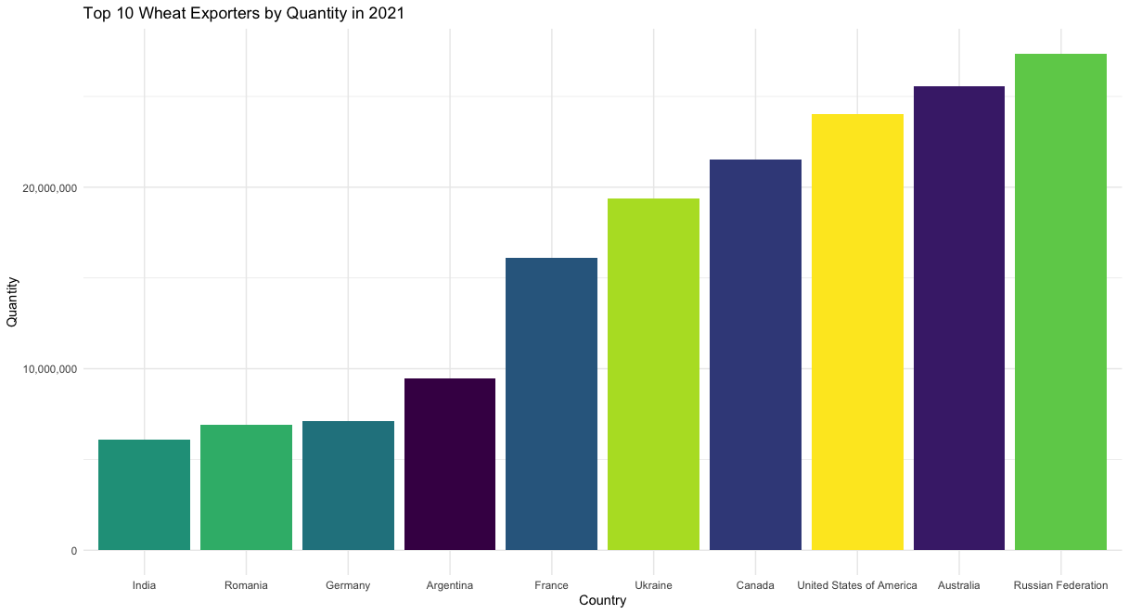
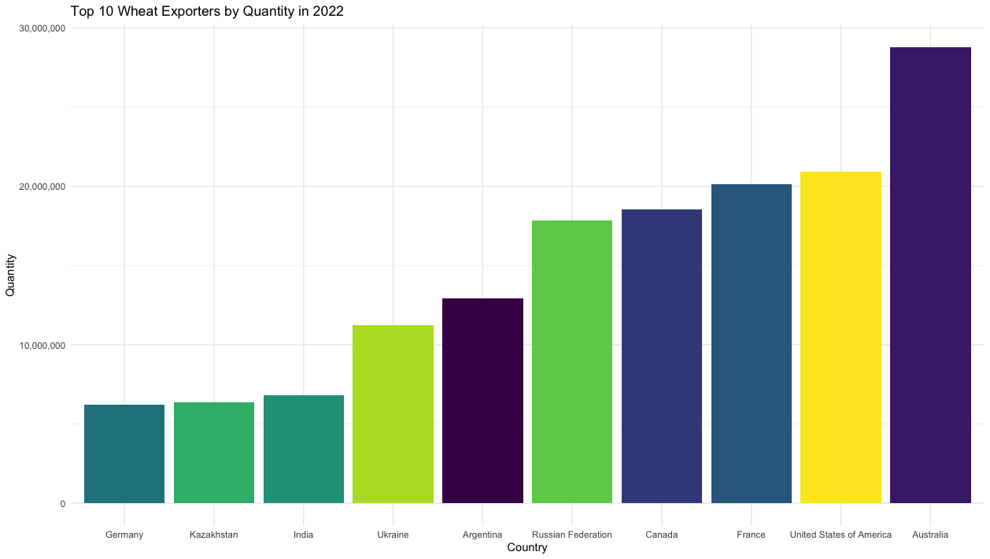
TOP 10 WHEAT EXPORTERS
2021
2022
Notes:
When we converted the data into a time series, we used their annual averages because of certain components in our dataset. After calculating the weighted averages for prices, we obtained this plot. It clearly shows four main peaks over the years.

Slide 12
TOP PRODUCER COUNTRIES
Notes:
İndia and china top producer but they do not export wheat, China (CHN) has the highest wheat production among the countries listed, with a volume just over 4 trillion units.
India (IND) follows as the second-highest producer, with production volumes just under 4 trillion units.
The United States (USA) appears to be the third-largest producer on the chart, with production volumes slightly less than 3 trillion units.
The other countries (AUS, CAN, KAZ, PAK, RUS, TUR, UKR) have lower wheat production volumes compared to the top three, ranging between approximately 1 and 2 trillion units.these are the top countries for past 19 years

Slide 13


CLIMATE DATA 1990-2023
INTERNATIONAL TRADE DATA 1990-2022
SUPPLY AND DISAPPEARANCES 2003-2023
COMBINED DATASET
COMMODITY PRICE DATA 1990-2022
2003-2022
CROP PRODUCTION DATA 1990-2023

Slide 14
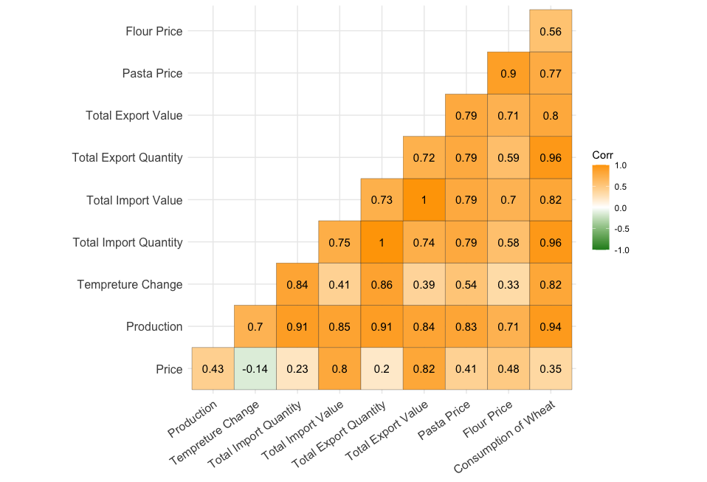
CORRELATION MATRIX
FEATURE SELECTION
Price
Total Export Value
Pasta Price
Flour Price
Consumption of Wheat
Production
Notes:
Without time dependency,
Total Import Quantity (VIF = 449.40562), among others, have extremely high VIF values, which indicates that these variables are highly multicollinear with one or more other independent variables in the model.
Production (VIF = 33.23933), Temperature Change (VIF = 19.15326), Total Import Value (VIF = 570.42092), Total Export Quantity (VIF = 542.60881), Total Export Value (VIF = 482.45615), and Consumption of Wheat (VIF = 83.69908) also have high VIF values, suggesting significant multicollinearity.
Pasta Price (VIF = 21.52803) and Flour Price (VIF = 26.92882) show elevated VIF values, indicating multicollinearity concerns but at a lower scale compared to others.
High VIF values suggest that the model has some predictor variables that are functions of other predictors, and it's a sign that the model may need to be simplified. You could consider removing some of these variables, combining them, or using techniques like principal component analysis (PCA) to reduce multicollinearity. Addressing multicollinearity is important because it can make the model unstable, exaggerate the statistical significance of an independent variable, and make the model sensitive to changes in the model, such as which variables are included.
Production: This likely refers to the quantity of wheat produced. It shows a high positive correlation with Total Import Quantity, Total Export Quantity, and Consumption of Wheat, suggesting that as production increases, these variables tend to increase as well.
Temperature Change: This could be referring to changes in climate or seasonal temperatures that affect wheat production. It has a high positive correlation with Production, indicating that temperature changes might be influencing wheat production.
Total Import Quantity and Total Import Value: These variables measure the amount and the monetary value of wheat imported. They are perfectly correlated with each other (1.00), which is expected since more quantity typically means more value, though not always in a 1:1 relationship due to price changes.
Total Export Quantity and Total Export Value: Similar to import variables, these refer to the amount and the monetary value of wheat exported and are also highly correlated with each other.
Flour Price and Pasta Price: These are likely the prices of flour and pasta, which are wheat derivatives. Flour price shows a moderate positive correlation with pasta price, suggesting that when the price of flour goes up, the price of pasta tends to increase as well.
Consumption of Wheat: This likely measures the amount of wheat consumed. It is highly correlated with wheat production, which makes sense as higher production might be linked to higher consumption, either directly or through increased exports.
he negative correlation between Price and Temperature Change might suggest that as temperatures change (potentially becoming more extreme), it might be negatively affecting the price of wheat, possibly through impacts on production or supply chains.
When forecasting the price of wheat, it would be important to consider the variables that show strong correlations with the price, as these might be significant predictors. However, high multicollinearity, as suggested by the high correlations, could be problematic for certain models like linear regression but might be handled well by models like Lasso Regression or by using dimensionality reduction techniques before modeling.

Slide 15


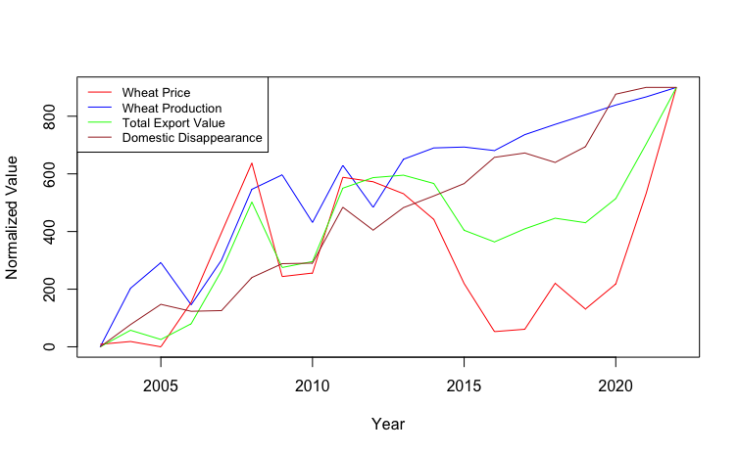
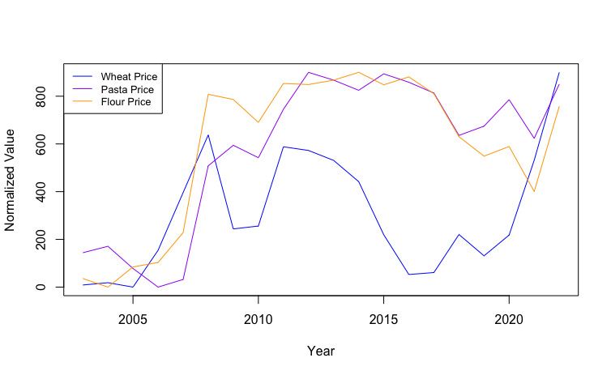
RELATION BETWEEN SELECTED VARIABLES
Record Harvest
Of Wheat After The Year 2012
Notes:
We see that after 2016 there is increase in wheat production almost linear due to the record harvests. Mention pasta.

Slide 16

3
DATA MODELING

Slide 17

MODELS
PREDICTION
FORECASTING
LINEAR REGRESSION MODEL
BASS MODEL
GENERALIZED BASS MODEL
LOCAL REGRESSION AND SPLINES
LASSO REGRESSION
ARIMA
ARMAX
EXPONENTIAL SMOOTHING
GENERALIZED ADDITIVE MODEL
Notes:
Linear Model : P=0.9 highky correlated at lag 1, residuals are starting to have some structure → they show harmonic behavior, mean 0 → positive autocorrelation
This is a sign that something is missing. 2 explanations:
o Bad specification of the model (used a linear model and maybe we needed a nonlinear one)
o We have omitted important
Bass model has good fit,
Generalized Bass model, adds internvention func which may speed or slows down the process for potential shocks
Regression splines are a form of regression analysis used to capture non-linear relationships. They divide the data into segments and fit a polynomial (usually of low degree, like cubic) to each segment.
Linear model
Bass Model v
Generilzed Bass model -shock
Local Regression with Splines
Forecasting
ARIMA ARMAX AUTO ARIMA GAM EXP SMOOH
Prediction
Gradient boosting
Explanantion
Forecasting
Expo smooth

Slide 18
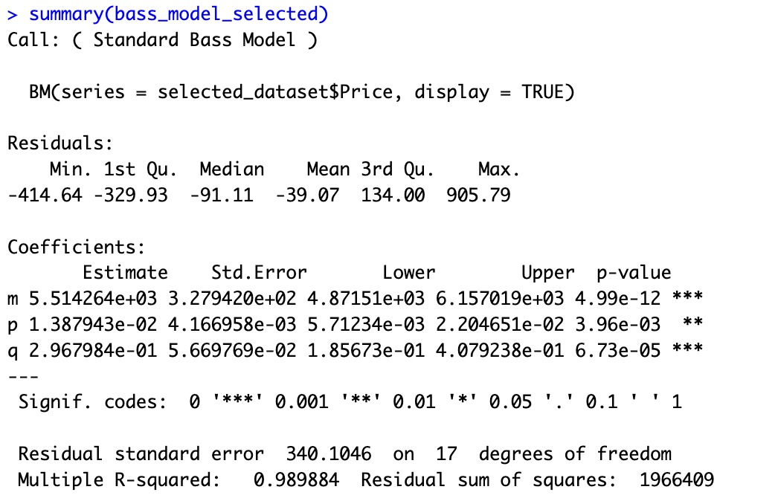
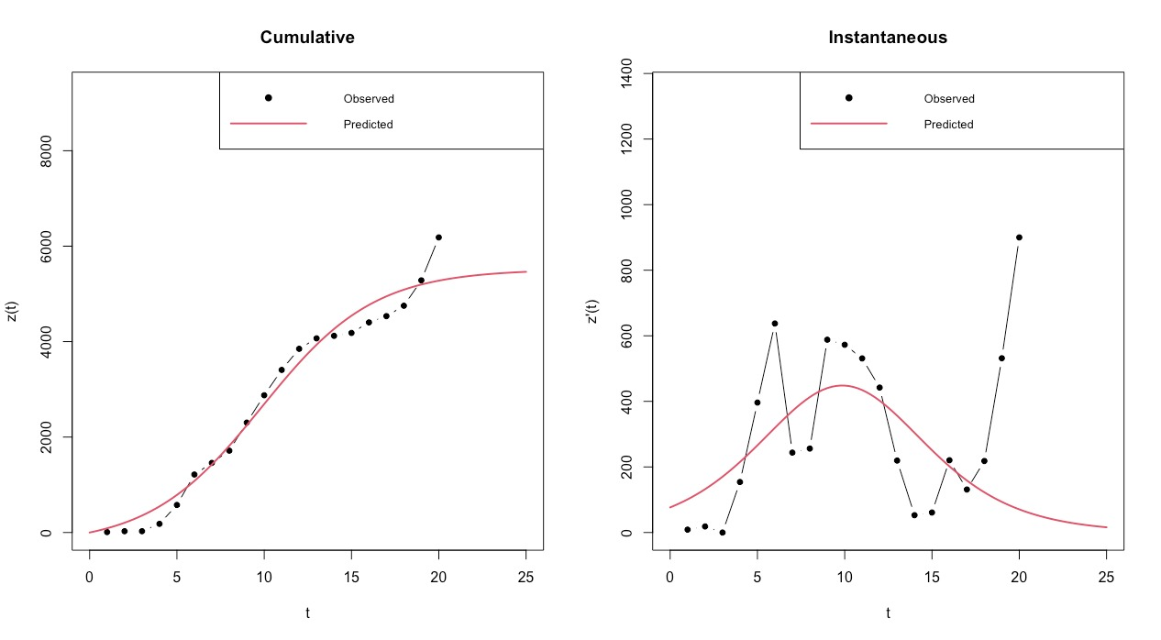
BASS MODEL
Cumulative data is almost an S-shaped curve
Instantaneous data is a Bell-shaped curve
The parameters are significant
Notes:
Summary of the Bass ModelCall. Key statistics like minimum, first quartile, median, mean, third quartile, and maximum are provided. They help understand the distribution and skewness of residuals.Coefficients:m: Total market potential or the limit market size.p: Coefficient of innovation, showing the rate of adoption due to external influences.q: Coefficient of imitation, indicating the rate of adoption due to internal influences (e.g., word-of-mouth).Estimate: The estimated value of each parameter.Std.Error: Standard error of the estimate.Lower and Upper: Bounds of a 95% confidence interval for the parameter estimates.p-value: Indicates the significance of each parameter (lower values suggest higher significance).Significance Codes: Indicate the statistical significance of the coefficients (* being highly significant).Residual standard error: Provides a measure of the quality of the model; lower values indicate a better fit.Multiple R-squared: Indicates the proportion of variance in the dependent variable that is predictable from the independent variables (close to 1 is better).Residual sum of squares: Total sum of squares of residuals; smaller values indicate a better fit.Forecast Evaluation MetricsMSE (Mean Squared Error): Measures the average of the squares of the errors or deviations (lower is better).RMSE (Root Mean Squared Error): Square root of MSE; provides a measure of the average error magnitude in the same units as the data (lower is better).AIC (Akaike Information Criterion): Measures the relative quality of statistical models for a given dataset. Balances model fit and complexity (lower is better).InterpretationThe output of the Bass Model indicates it has captured the trends in your "Price" data with significant coefficients (indicated by the low p-values for m, p, and q).The model's goodness of fit is high (indicated by the high R-squared value).However, the MSE and RMSE are relatively large, suggesting that the model's predictions have a significant average error from the actual values. This might be due to the Bass Model typically being more suited for modeling adoption curves rather than continuous variables like prices.The AIC value provides a basis for model comparison; if you fit different models to this data, the one with the lowest AIC would generally be preferred.When interpreting these results, it's crucial to consider the appropriateness of the Bass Model for your data. This model is conventionally used for forecasting adoption and diffusion phenomena, not typically for predicting continuous variables such as prices unless they follow a similar diffusion pattern.

Slide 19
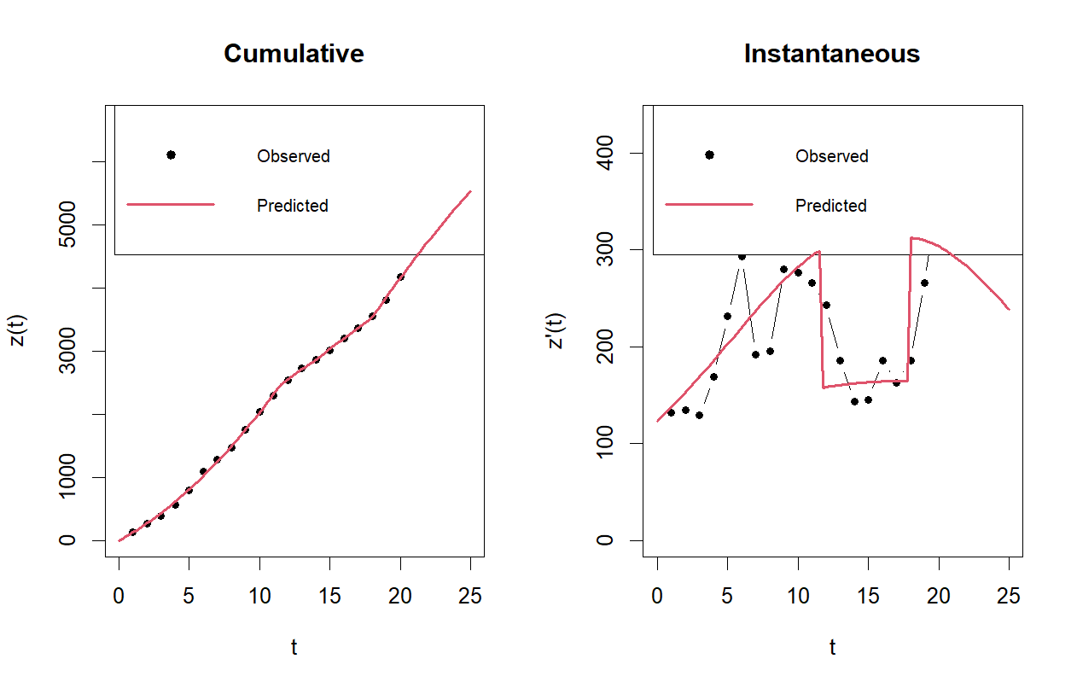
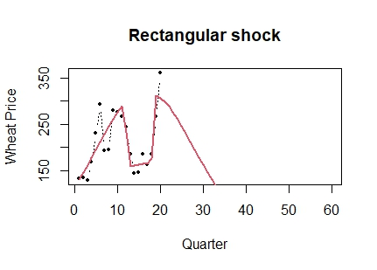
GENERALIZED BASS MODEL: RECTANGULAR SHOCK
Rectangular shock (2016-2021) due to mass production, followed by the Russian invasion of Ukraine.
ERROR MEASURES
MSE: 19673.17
RMSE: 140.2611
Notes:
The output of these models will give you insights into how these external shocks might affect the adoption or diffusion process represented by your "Price" data. Remember, the use of the Bass and Generalized Bass Models is more conventional in scenarios like product adoption rates, so ensure their applicability to your dataset.

Slide 20
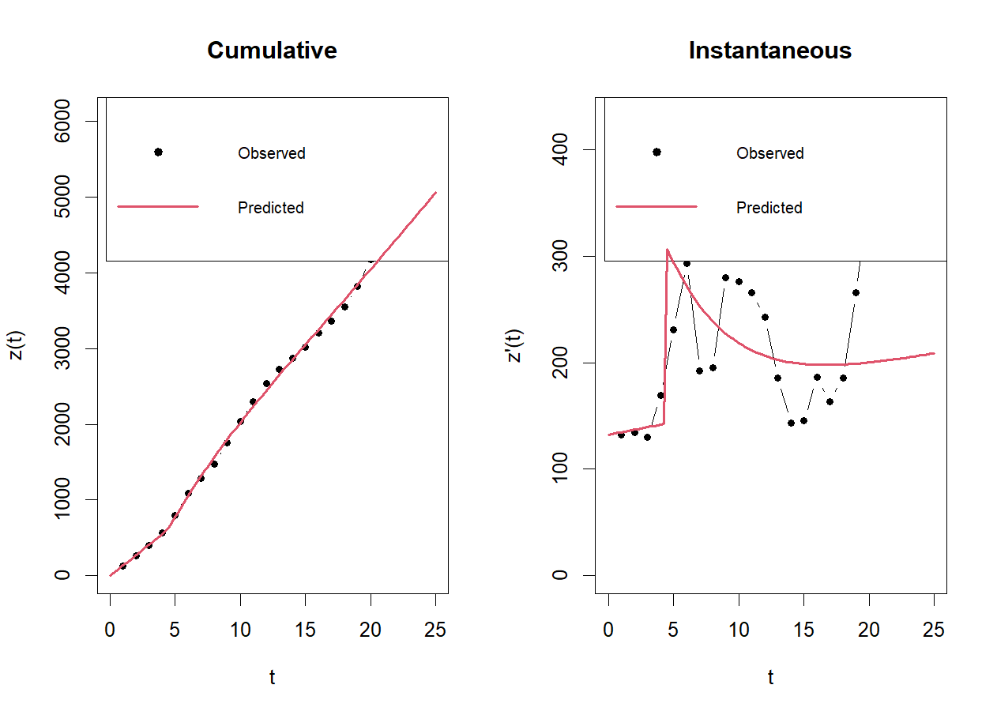
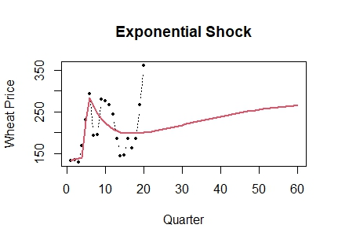
GENERALIZED BASS MODEL: EXPONENTIAL SHOCK
The 2008 global food crisis was a pivotal event that led to a substantial increase in food prices worldwide.
ERROR MEASURES
MSE: 4106.724
RMSE: 64.08373

Slide 21
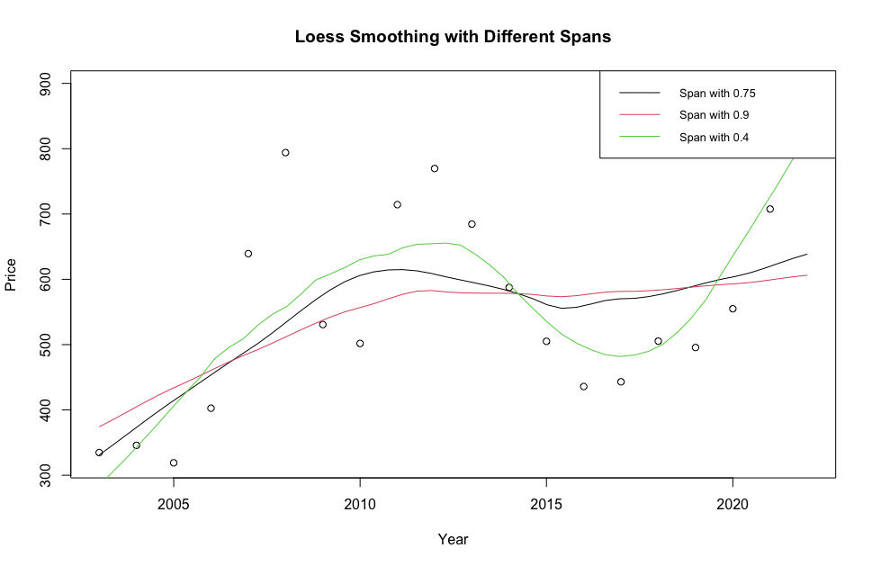
LOCAL REGRESSION (LOESS)
Higher the span the higher level of smoothing.
Error Metrics (span=0.4):
MSE: 1651.43
RMSE: 40.64
MAE: 35.41
Notes:
Local regression and splines are techniques for smoothing and modeling non-linear relationships in data.
Plotting Data: You begin by plotting Year against Price to visualize the relationship.
sm.regression: This function from the sm package applies local regression to the data. The h parameter controls the bandwidth, which determines the degree of smoothing.
Different Bandwidths: You experiment with different values of h (10, 5, 15) to see how the smoothness of the fitted line changes. Smaller h values give more flexible fits, while larger h values give smoother fits.
Loess Smoothing:
loess.smooth: Applies Loess smoothing to the data. Different span values (0.9, 0.4) alter the degree of smoothing. The span parameter is analogous to the h parameter in local regression.
Regression Splines:
Spline Fitting: You fit spline models to the data using the bs function for creating basis splines. Different models are created by varying the number and location of knots or specifying degrees of freedom.
Model Variations: Models with 2 internal knots, no internal knots, 17 knots, and another with 4 degrees of freedom are created to capture different levels of flexibility.
Predictions: You generate predictions for these models over a sequence of years to visualize the spline fit.
Plotting: The fitted spline models are plotted against the original data to visualize their fit.
2. Model Evaluation
MSE and RMSE Calculation: For each spline model, you calculate the Mean Squared Error (MSE) and Root Mean Squared Error (RMSE), which are measures of model accuracy. These metrics help in comparing the performance of different spline models.
Interpretation: Lower values of MSE and RMSE indicate a better fit of the model to the data. By comparing these values for different models, you can assess which model captures the relationship between Year and Price more effectively.
General Explanation and Usage
This code is valuable for exploratory data analysis and model building when you suspect that the relationship between the variables is non-linear.
The different techniques (local regression, Loess, splines) offer varying degrees of flexibility and are useful for understanding complex relationships in your data without assuming a specific functional form.
By comparing various models, you can choose the one that best balances the trade-off between overfitting (too flexible) and underfitting (too rigid).

Slide 22
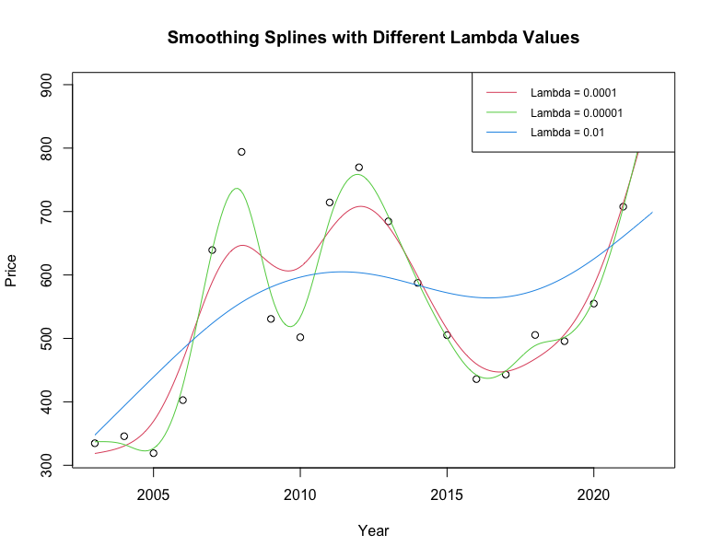
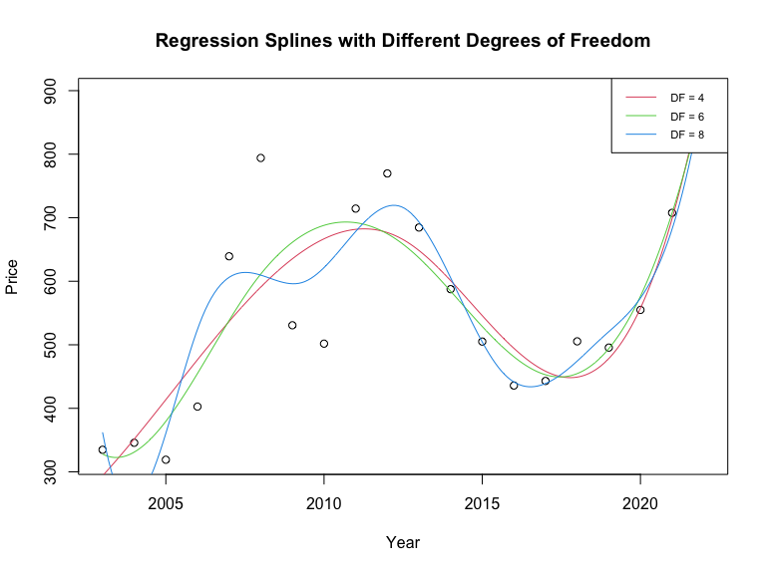
REGRESSION SPLINE
Error Metrics (lambda=0.01):
MSE: 41599.09
RMSE: 203.96
MAE: 123.57
Notes:
Plotting Data: You begin by plotting Year against Price to visualize the relationship.
sm.regression: This function from the sm package applies local regression to the data. The h parameter controls the bandwidth, which determines the degree of smoothing.
Different Bandwidths: You experiment with different values of h (10, 5, 15) to see how the smoothness of the fitted line changes. Smaller h values give more flexible fits, while larger h values give smoother fits.
Loess Smoothing:
loess.smooth: Applies Loess smoothing to the data. Different span values (0.9, 0.4) alter the degree of smoothing. The span parameter is analogous to the h parameter in local regression.
Regression Splines:
Spline Fitting: You fit spline models to the data using the bs function for creating basis splines. Different models are created by varying the number and location of knots or specifying degrees of freedom.
Model Variations: Models with 2 internal knots, no internal knots, 17 knots, and another with 4 degrees of freedom are created to capture different levels of flexibility.
Predictions: You generate predictions for these models over a sequence of years to visualize the spline fit.
Plotting: The fitted spline models are plotted against the original data to visualize their fit.
2. Model Evaluation
MSE and RMSE Calculation: For each spline model, you calculate the Mean Squared Error (MSE) and Root Mean Squared Error (RMSE), which are measures of model accuracy. These metrics help in comparing the performance of different spline models.
Interpretation: Lower values of MSE and RMSE indicate a better fit of the model to the data. By comparing these values for different models, you can assess which model captures the relationship between Year and Price more effectively.
General Explanation and Usage
This code is valuable for exploratory data analysis and model building when you suspect that the relationship between the variables is non-linear.
The different techniques (local regression, Loess, splines) offer varying degrees of flexibility and are useful for understanding complex relationships in your data without assuming a specific functional form.
By comparing various models, you can choose the one that best balances the trade-off between overfitting (too flexible) and underfitting (too rigid).

Slide 23
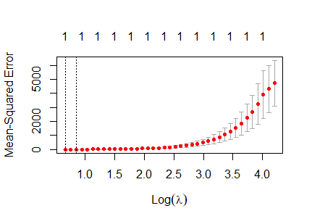
LASSO REGRESSION
Prediction with lambda=1.945 (best):
MSE: 368.238
RMSE: 19.189

Slide 24

4
FORECASTING

Slide 25
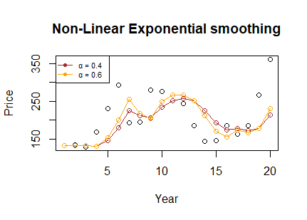
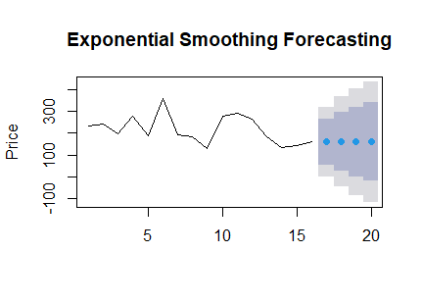
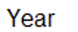
SIMPLE EXPONENTIAL SMOOTHING
Error Metrics:
MSE: 3090.756
RMSE: 55.594
AIC: 187.416
α = 0.6 shows a better fit → lower error

Slide 26
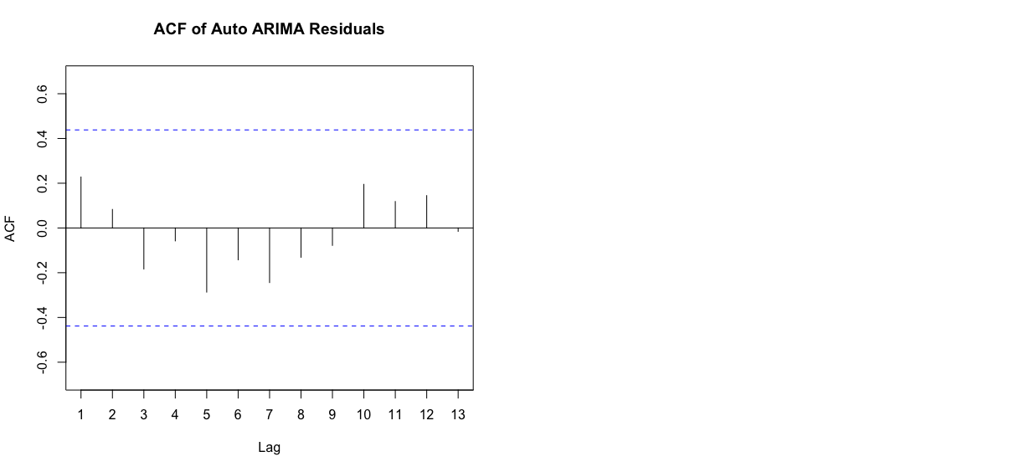

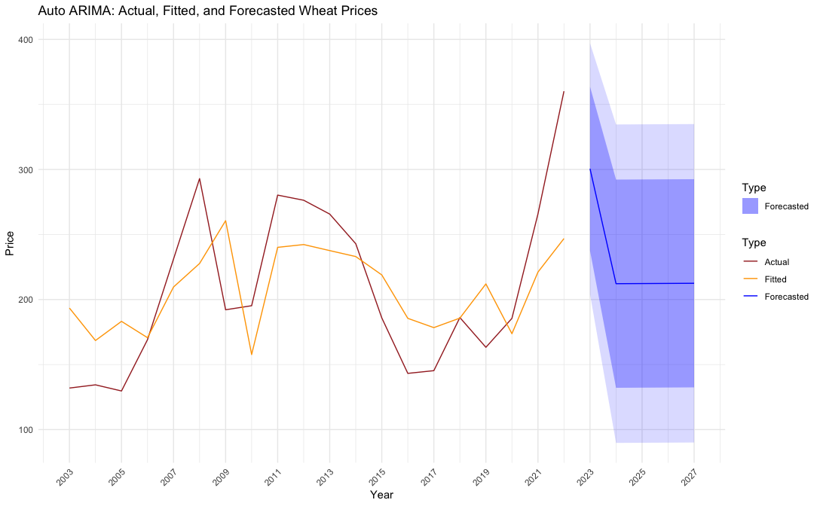
FORECASTING WHEAT PRICES WITH ARIMA MODELS
Auto ARIMA (0,0,1) Model
Metrics:
RMSE: 46.838
MAPE: 19.903
AIC: 217.568
Notes:
The residuals are normally distributed
One significant peak in ACF → 1 AR
80% and 95% confidence intervals.
Slide 1: Introduction to ARIMA Model
Title: Understanding ARIMA (1,0,1) for Wheat Price Forecasting
Content Explanation:
Briefly introduce the ARIMA model and its objective to forecast wheat prices.
Explain the components of ARIMA(1,0,1):
1 AR Term (p=1): Current value influenced by its immediate predecessor.
0 Differencing (d=0): Data is stationary; no need for differencing.
1 MA Term (q=1): Model incorporates the moving average of the previous term.
Highlight the importance of this model in agricultural economics and market prediction.
Slide 2: Time Series Creation and Initial Analysis
Title: Constructing and Analyzing the Time Series
Content Explanation:
Discuss the process of converting wheat price data into a time series object.
Explain the significance of plotting the time series to identify trends, seasonality, or anomalies.
Use a visual (if available) to show the time series plot.
Slide 3: Fitting the ARIMA Model
Title: Fitting ARIMA(1,0,1) to Wheat Prices
Content Explanation:
Outline the steps in fitting the ARIMA(1,0,1) model to the data.
Discuss the importance of model summary and its coefficients.
A brief mention of the statistical significance of these coefficients in the model.
Slide 4: Model Diagnostics
Title: Diagnosing the ARIMA Model
Content Explanation:
Explain the process of analyzing residuals to ensure no patterns are missed.
Importance of using tsdisplay() for a visual inspection of residuals, ACF, and PACF.
Present a visual (if available) showing the diagnostic plots.
Slide 5: Actual vs. Fitted Values Analysis
Title: Actual vs. Fitted Wheat Price (ARIMA 1,0,1)
Content Explanation:
Describe the comparison between actual wheat prices and those fitted by the ARIMA model.
Highlight how this evaluation helps in assessing the model's accuracy in capturing historical trends.
Include the provided visualization for a clearer understanding.
Slide 6: Forecasting Future Wheat Prices
Title: Forecast Wheat Price (ARIMA 1,0,1)
Content Explanation:
Outline the steps taken to forecast wheat prices for the next 5 years using the model.
Discuss the significance of visualizing these forecasts for future price trend insights.
Present the forecast plot to demonstrate projected trends.
Slide 7: Model Evaluation and Comparison
Title: Evaluating and Comparing ARIMA Models
Content Explanation:
Discuss the calculation and relevance of MSE, RMSE, and AIC in evaluating the model’s performance.
Introduce auto.arima() as a method for automatic model selection.
Compare the ARIMA(1,0,1) model with the auto-selected model, if applicable.
Slide 8: Conclusion and Implications
Title: Concluding Remarks and Practical Implications
Content Explanation:
Summarize the effectiveness of the ARIMA(1,0,1) model in forecasting wheat prices.
Discuss the implications of these findings for market prediction and agricultural economics.
Open the floor for questions or discussions.

Slide 27
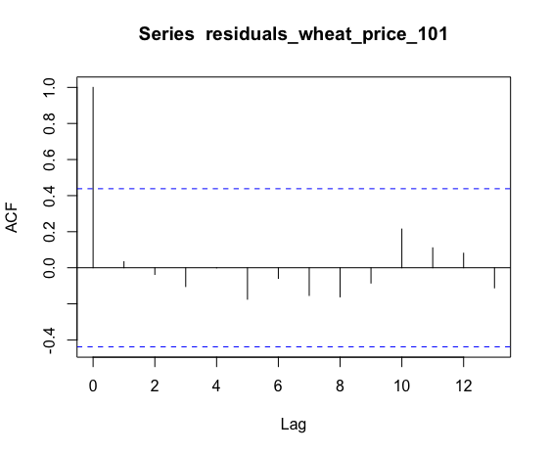
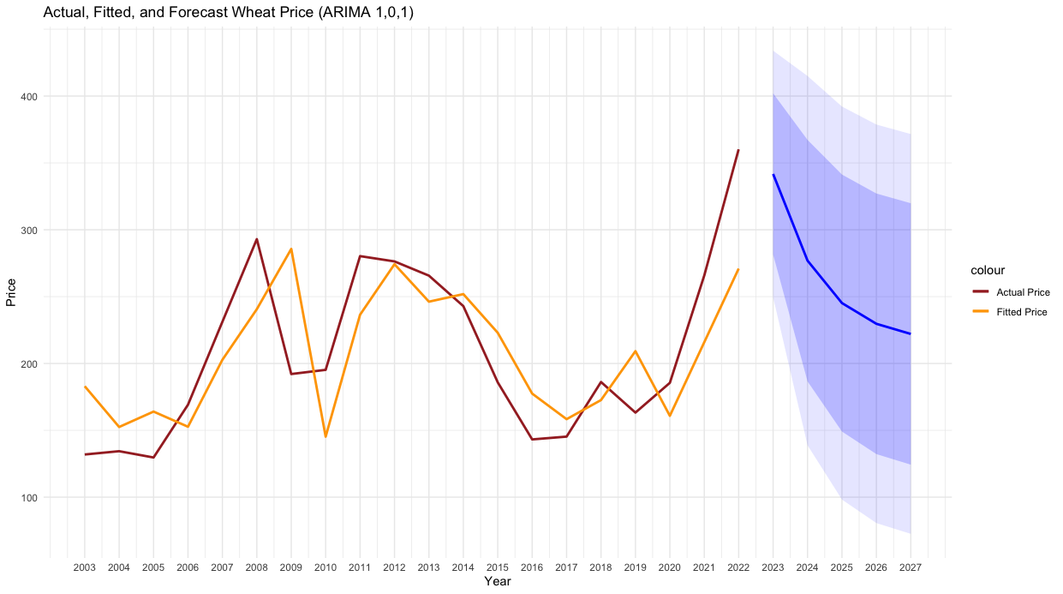
FORECASTING WHEAT PRICES WITH ARIMA MODELS
ARIMA(1,0,1) Model Metrics:
RMSE: 43.381
MAPE: 18.268%
AIC: 216.862
Notes:
The residuals are normally distributed
One significant peak in ACF → 1 AR
80% and 95% confidence intervals.
Slide 1: Introduction to ARIMA Model
Title: Understanding ARIMA (1,0,1) for Wheat Price Forecasting
Content Explanation:
Briefly introduce the ARIMA model and its objective to forecast wheat prices.
Explain the components of ARIMA(1,0,1):
1 AR Term (p=1): Current value influenced by its immediate predecessor.
0 Differencing (d=0): Data is stationary; no need for differencing.
1 MA Term (q=1): Model incorporates the moving average of the previous term.
Highlight the importance of this model in agricultural economics and market prediction.
Slide 2: Time Series Creation and Initial Analysis
Title: Constructing and Analyzing the Time Series
Content Explanation:
Discuss the process of converting wheat price data into a time series object.
Explain the significance of plotting the time series to identify trends, seasonality, or anomalies.
Use a visual (if available) to show the time series plot.
Slide 3: Fitting the ARIMA Model
Title: Fitting ARIMA(1,0,1) to Wheat Prices
Content Explanation:
Outline the steps in fitting the ARIMA(1,0,1) model to the data.
Discuss the importance of model summary and its coefficients.
A brief mention of the statistical significance of these coefficients in the model.
Slide 4: Model Diagnostics
Title: Diagnosing the ARIMA Model
Content Explanation:
Explain the process of analyzing residuals to ensure no patterns are missed.
Importance of using tsdisplay() for a visual inspection of residuals, ACF, and PACF.
Present a visual (if available) showing the diagnostic plots.
Slide 5: Actual vs. Fitted Values Analysis
Title: Actual vs. Fitted Wheat Price (ARIMA 1,0,1)
Content Explanation:
Describe the comparison between actual wheat prices and those fitted by the ARIMA model.
Highlight how this evaluation helps in assessing the model's accuracy in capturing historical trends.
Include the provided visualization for a clearer understanding.
Slide 6: Forecasting Future Wheat Prices
Title: Forecast Wheat Price (ARIMA 1,0,1)
Content Explanation:
Outline the steps taken to forecast wheat prices for the next 5 years using the model.
Discuss the significance of visualizing these forecasts for future price trend insights.
Present the forecast plot to demonstrate projected trends.
Slide 7: Model Evaluation and Comparison
Title: Evaluating and Comparing ARIMA Models
Content Explanation:
Discuss the calculation and relevance of MSE, RMSE, and AIC in evaluating the model’s performance.
Introduce auto.arima() as a method for automatic model selection.
Compare the ARIMA(1,0,1) model with the auto-selected model, if applicable.
Slide 8: Conclusion and Implications
Title: Concluding Remarks and Practical Implications
Content Explanation:
Summarize the effectiveness of the ARIMA(1,0,1) model in forecasting wheat prices.
Discuss the implications of these findings for market prediction and agricultural economics.
Open the floor for questions or discussions.

Slide 28
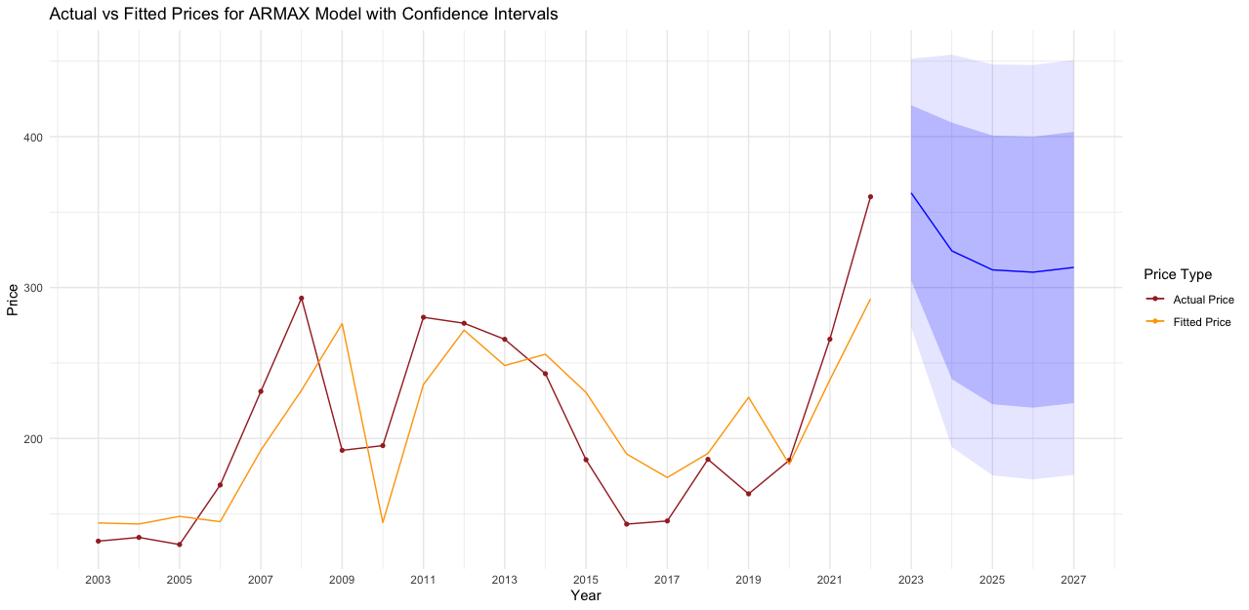
FORECASTING WHEAT PRICES WITH ARMAX MODEL
ARMAX Model Metrics:
RMSE: 40.577
AIC: 216.098
MAPE: 16.467
Notes:
Title: Building the ARMAX Model
Content:
Explanation of the ARMAX model: AutoRegressive Moving Average with eXogenous inputs.
Model specification: Order (1,0,1) and inclusion of 'Year' as an exogenous variable.
Title: Forecasting Future Prices
Creation of future_data dataframe for prediction.
Utilization of the ARMAX model for forecasting next five years’ wheat prices.

Slide 29
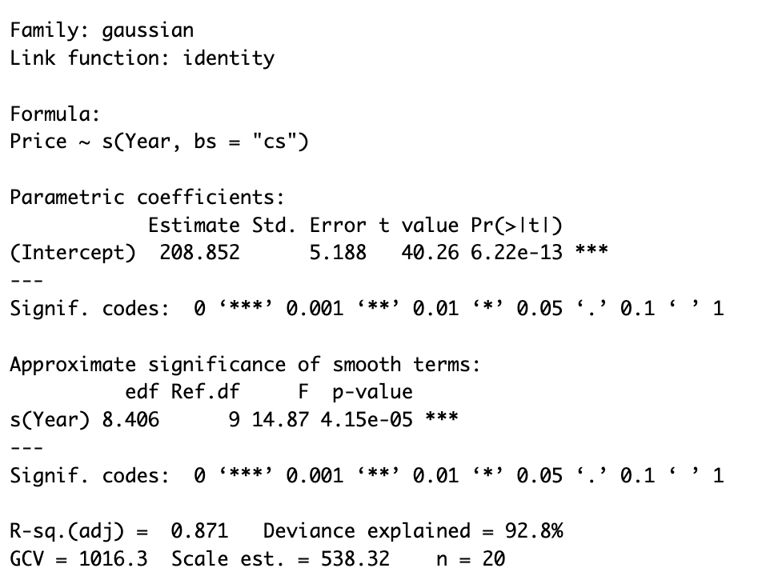
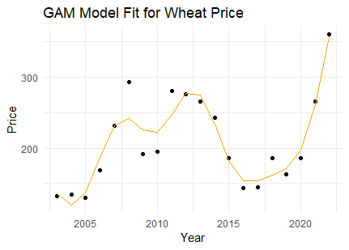
GENERALIZED ADDITIVE MODEL (GAM)
Error Metrics:
RMSE:19.24
AIC: 195.25
MAPE : 7.045 %
Notes:
Analysis of Your GAM Results:
Model Summary:
Parametric Coefficient: The intercept is significant, which is a common aspect in regression models.
Smooth Terms: The s(Year) term is highly significant, indicating that the year has a non-linear relationship with the wheat price, which the GAM is capturing.
Deviance Explained: 89.6% deviance explained is quite high, suggesting the model fits the data well.
Adjusted R²: At 0.818, this also indicates a good fit.
Model Predictions:
You've correctly generated predictions for both the existing data (predictions_gam_wheatprice) and future values (predictions_future).
The plotting of the model fit and future forecasts is appropriate.
Error Metrics:
MSE and RMSE: The MSE and RMSE are relatively low, which suggests that the model's predictions are close to the actual values.
AIC: The AIC (Akaike Information Criterion) is used for model comparison; lower values are generally better.
Suggestions for Improvement:
Data Inspection: Prior to modeling, thoroughly inspect and preprocess the data. Check for outliers, missing values, or anomalies that might affect the model.
Feature Engineering: Consider including more features in your model if available, such as economic indicators, weather patterns, or global market trends, which might influence wheat prices.
Model Complexity: Be cautious about the model complexity. A highly flexible model might overfit the training data. If you have many years of data, you might experiment with adjusting the smoothness of the s(Year) term.
Validation: Implement a robust validation method. Split your data into training and testing sets, or use cross-validation to assess the model's predictive performance.
Diagnostic Plots: Use diagnostic plots to check for any patterns in the residuals, which can indicate model misspecification or heteroscedasticity.
Compare with Other Models: Compare GAM with other models (like linear regression, random forest, or ARIMA) to gauge its performance.
Confidence Intervals: Add confidence intervals to your forecasts to provide a range of plausible values.
Interpretability: While GAMs are excellent at capturing non-linear relationships, they can be less interpretable than simpler models. Ensure you can interpret and explain the model's output, especially if it's for a business or decision-making context.
Regular Updates: For forecasting models, it's crucial to regularly update them with new data to maintain their accuracy over time.

Slide 30
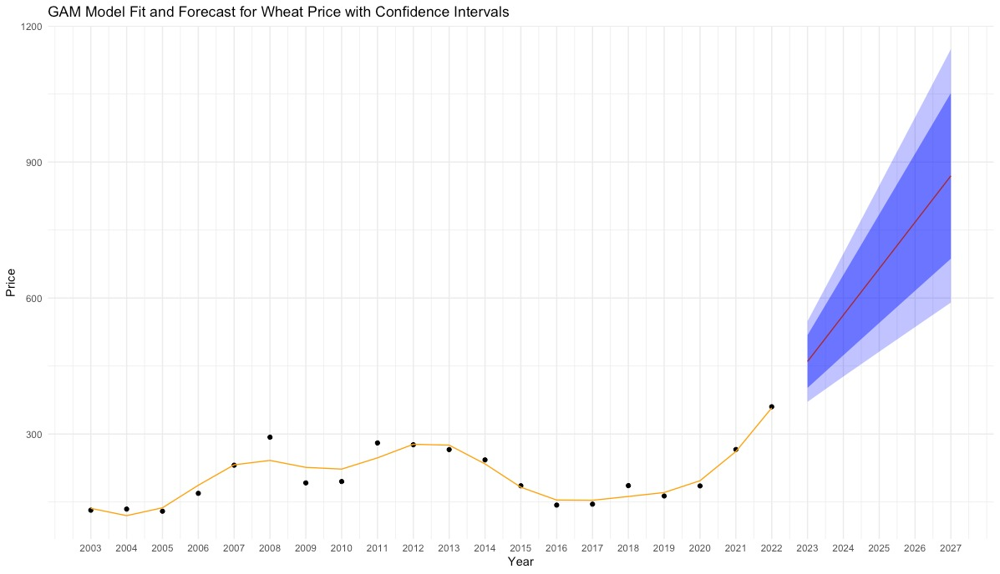
GENERALIZED ADDITIVE MODEL (GAM)
Notes:
Analysis of Your GAM Results:
Model Summary:
Parametric Coefficient: The intercept is significant, which is a common aspect in regression models.
Smooth Terms: The s(Year) term is highly significant, indicating that the year has a non-linear relationship with the wheat price, which the GAM is capturing.
Deviance Explained: 89.6% deviance explained is quite high, suggesting the model fits the data well.
Adjusted R²: At 0.818, this also indicates a good fit.
Model Predictions:
You've correctly generated predictions for both the existing data (predictions_gam_wheatprice) and future values (predictions_future).
The plotting of the model fit and future forecasts is appropriate.
Error Metrics:
MSE and RMSE: The MSE and RMSE are relatively low, which suggests that the model's predictions are close to the actual values.
AIC: The AIC (Akaike Information Criterion) is used for model comparison; lower values are generally better.
Suggestions for Improvement:
Data Inspection: Prior to modeling, thoroughly inspect and preprocess the data. Check for outliers, missing values, or anomalies that might affect the model.
Feature Engineering: Consider including more features in your model if available, such as economic indicators, weather patterns, or global market trends, which might influence wheat prices.
Model Complexity: Be cautious about the model complexity. A highly flexible model might overfit the training data. If you have many years of data, you might experiment with adjusting the smoothness of the s(Year) term.
Validation: Implement a robust validation method. Split your data into training and testing sets, or use cross-validation to assess the model's predictive performance.
Diagnostic Plots: Use diagnostic plots to check for any patterns in the residuals, which can indicate model misspecification or heteroscedasticity.
Compare with Other Models: Compare GAM with other models (like linear regression, random forest, or ARIMA) to gauge its performance.
Confidence Intervals: Add confidence intervals to your forecasts to provide a range of plausible values.
Interpretability: While GAMs are excellent at capturing non-linear relationships, they can be less interpretable than simpler models. Ensure you can interpret and explain the model's output, especially if it's for a business or decision-making context.
Regular Updates: For forecasting models, it's crucial to regularly update them with new data to maintain their accuracy over time.

Slide 31
MODEL COMPARISON: FORECASTS
 | MSE | RMSE | MAE | MAPE
ARIMA | 1881.914 | 43.381 | 36.312 | 18.268
AUTO ARIMA | 2193.844 | 46.838 | 39.278 | 19.903
ARMAX | 1646.556 | 40.577 | 33.166 | 16.467
GAM | 370.151 | 19.24 | 14.160 | 7.045
Exponential smoothing | 3090.756 | 55.594 | NA | NA

Slide 32

CONCLUSION
Forecasting with GAM has the best performance with an error of 19$.
The best model for prediction was Lasso Regression.
Production and total import quantities are the most important factors influencing wheat prices.
$19 per tonne
$0.019 per kilogram error with GAM

Slide 33



LIMITATIONS & FUTURE WORK
Future work can develop models like regression trees with more data.
Include more diverse data such as satellite images for crop assessment.
Examine the level of poverty for potential food crises.

Slide 34

When pasta prices rise, it's not just the dough you're paying for! It's a noodle-knotty tale – wheat prices swaying like spaghetti, production in a pasta mess, and exports taking surprising turns, and occasionally, the 'pasta-bilities' of geopolitical affairs adding a pinch of unpredictability.

Slide 35
THANK YOU!

